Slide 1
Alarm Box
Using Arduino and Sensor

Slide 2
INTRODUCTION
In this project, I am going to make an alarm box using the HC-SR04 ultrasonic sensor. The ultrasonic sensor used in this project is used as a distance sensor, it will tell us the distance at which the object is placed. Using this distance value, we will turn the buzzer on or off.

Slide 3
REQUIRED COMPONENTS
Arduino Nano
HC-SR04 Ultrasonic sensor
Buzzer
Connecting Wires
Breadboard
LED

Slide 4
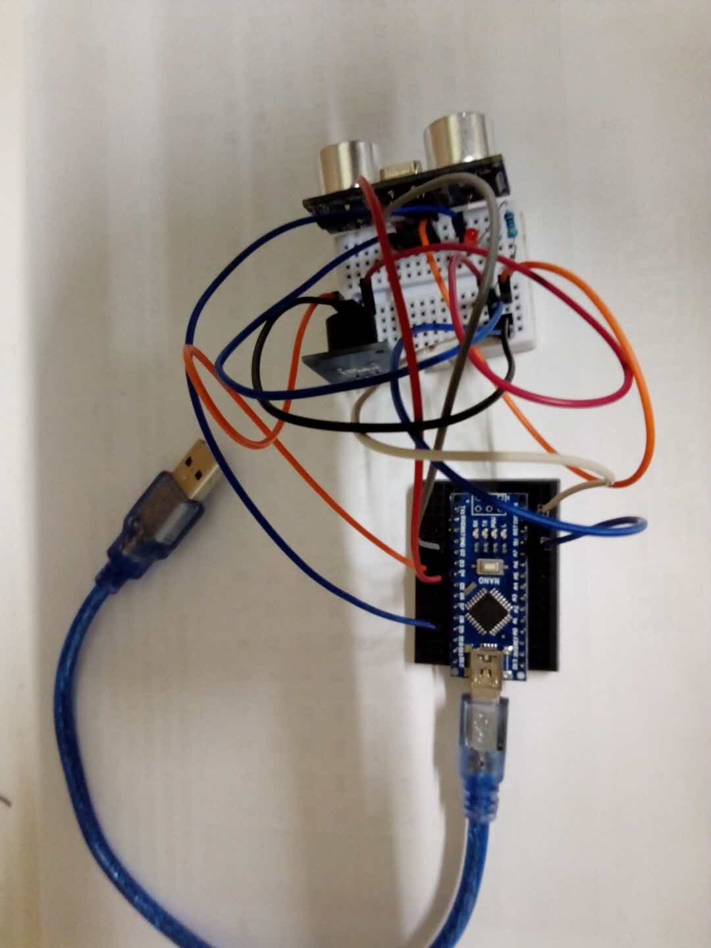
CIRCUIT DIAGRAM

Slide 6
APPLICATIONS
Alarmbox can be used to protect any room or any portion of a room from unauthorized person
We can check the arrival of anybody on the door of a room by alarm

